Slide 1


GPU Programming (in CUDA)
Fall 2018
Julian Gutierrez
Session 11

Slide 2
Outline
Applications
Parallel Reduction
Prefix Sum (Scan)
Histogram
Convolution

Slide 3
Parallel Reduction
A popular class of computation
Goal: To master the concept of control divergence through reduction trees (how to be work efficient).

Slide 4
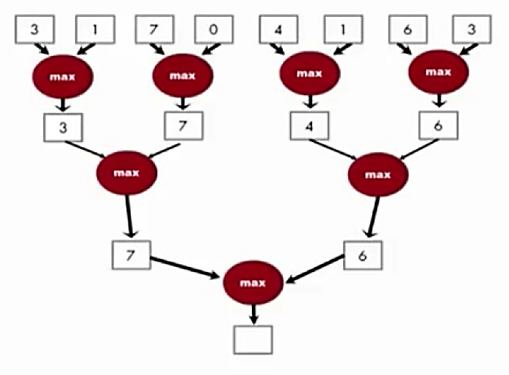
Parallel Reduction
Example
Calculate Max Value from vector:

Slide 5
Parallel Reduction
Example
Calculate Max Value from vector:
A parallel reduction tree algorithm performs N-1 operations in log(N) steps

Slide 6
Parallel Reduction
A commonly used strategy for processing large input data sets
There is no required order of processing elements in a data set (associative and commutative)
Partition the data set into smaller chunks
Have each thread process a chunk
Use a reduction tree to summarize the results from each chunk into the final answer
Google and Hadoop MapReduce frameworks are examples of this pattern
We will focus on the reduction tree step for now.

Slide 7
Parallel Reduction
Example: Handling privatization
Multiple threads write into an output location
Replicate the output location so that each thread has a private output location
Use a reduction tree to combine the values of private locations into the original output location

Slide 8
Parallel Reduction
Use: Summarize a set of input values into one value using a “reduction operation”
Max
Min
Sum
Product
You need to initialize the result as an identity value for the reduction operation
Smallest possible value for max reduction
Largest possible value for min reduction
0 for sum reduction
1 for product reduction

Slide 9
Parallel Reduction
For N input values, the reduction tree performs:
(1/2)N + (1/4)N + (1/8)N + … (1/N) = N-1 operations
In log(N) steps – 1 000 000 input values take 20 steps
Assuming that we have enough execution resources
Average parallelism (N-1)/log(N)
For N = 1 000 000 average parallelism is 50 000
However, peak resource requirement is 500 000!
This is a work-efficient parallel algorithm
The amount of work done is comparable to sequential
Many parallel algorithms are not work efficient

Slide 10
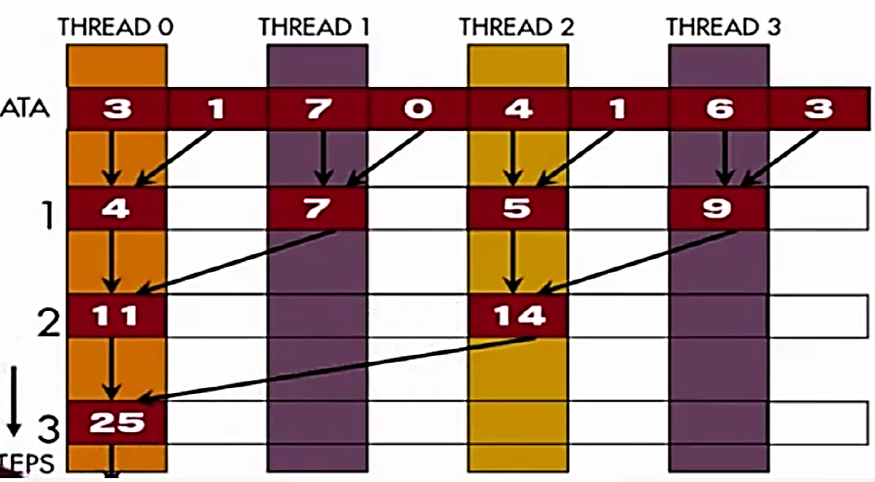
Parallel Reduction
An example

Slide 11
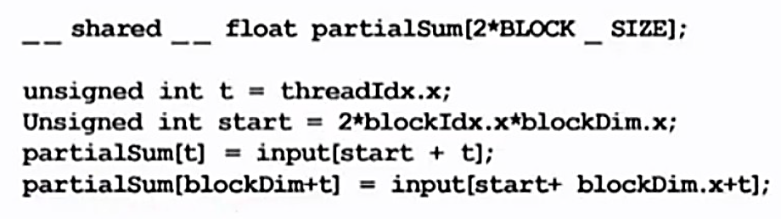
Parallel Reduction
An example
Each thread block takes 2*BlockDim input elements
Each threads loads 2 elements into shared memory
Notes:
Example:
Block size = 4 (tid = 0-3)
Vector = 3 1 7 0 4 1 6 3

Slide 12
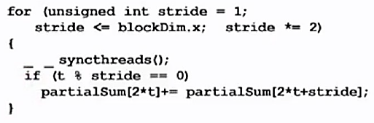
Parallel Reduction
Why do we need syncthreads()?
Thread 0 in each thread block write the sum of the thread block in partialSum[0] into a vector indexed by the blockIdx.x
There can be a large number of such sums if the original vector is very large
The host code may iterate and launch another kernel
If there are only a small number of sums, the host can simply transfer the data back and add them together
Notes:
Partial sum is in shared memory?
Do example on the board

Slide 13
Parallel Reduction

Slide 14
Parallel Reduction

Slide 15
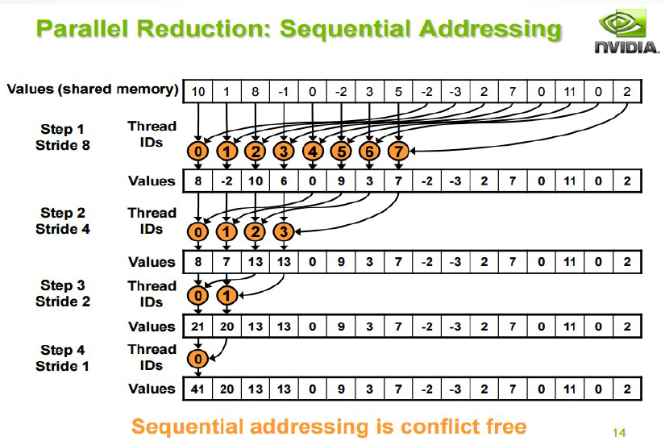
Parallel Reduction
A better reduction?

Slide 16
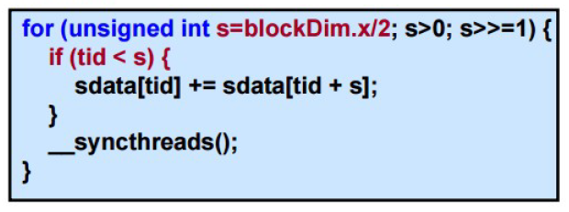
Parallel Reduction
There’s a problem
Idle threads!
Half of the threads are idle on first loop iteration!
This is wasteful….

Slide 17
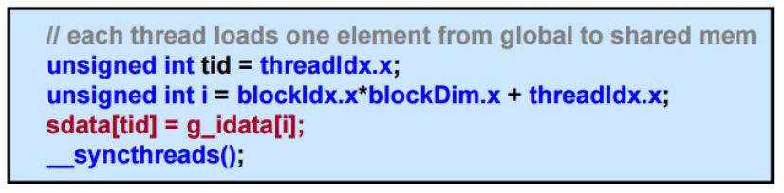
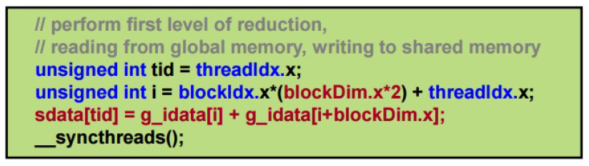
Parallel Reduction
Halve the number of blocks, and replace single load:
With two loads and first add of the reduction:
Notes:
A few techniques to improve even further the performance

Slide 18
Parallel Reduction
Unrolling the last warp
As reduction proceeds, # “active” threads decreases
When s <= 32, we have only one warp left
Instructions are SIMD synchronous within a warp
That means when s <= 32:
We don’t need to __syncthreads()
We don’t need “if (tid < s)” because it doesn’t save any work
Lets unroll the last 6 iterations of the inner loop

Slide 19
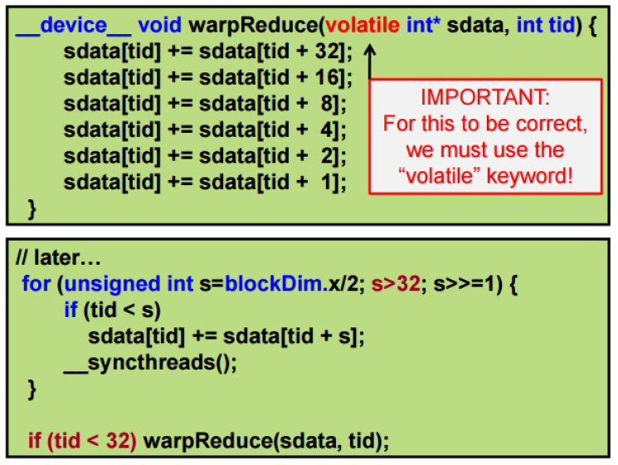
Parallel Reduction
Note: This saves useless work in all warps, not just the last one!
Without unrolling, all warps execute every iteration of the for loop and if statement

Slide 20
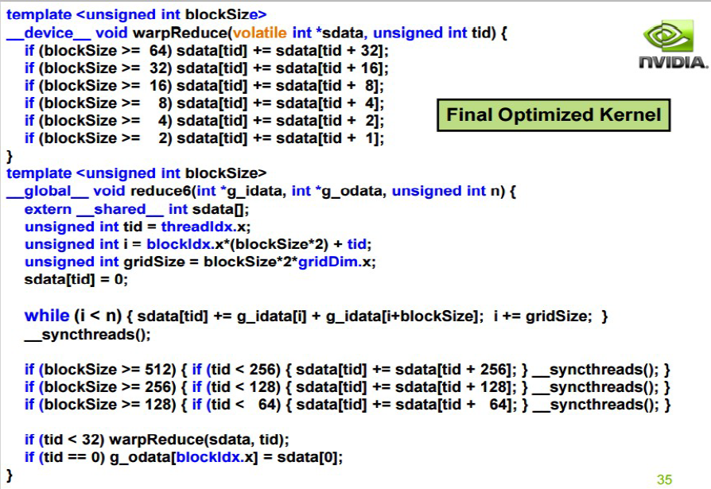
Parallel Reduction

Slide 21
Parallel Reduction
Please note: this warp synchronized technique only works in older models. After Volta, this technique is no longer valid due to the change in GPU architecture.
More on this:
https://devblogs.nvidia.com/cooperative-groups/
https://devblogs.nvidia.com/inside-volta/

Slide 22
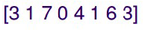
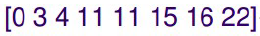
Prefix Sum (Scan)
Definition
Prefix sum, cumulative sum, inclusive scan, or simply scan of a sequence of numbers x0, x1, x2, ... Gives a second sequence of numbers y0, y1, y2, ..., the sums of prefixes (running totals) of the input sequence.
Any binary operation (not just the addition operation).
Example
If (+) is addition, then scan on the set:
Returns the set:
Note: Exclusive scan: last input element is not included in the result

Slide 23
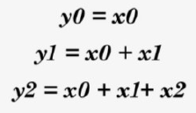
Prefix Sum (Scan)
A Naïve inclusive parallel Scan
Assign one thread to calculate each y element
Have every thread add up all x elements needed for the y element
Note: Parallel programming is easy as long as you do not care about performance
Notes:
Write the code?

Slide 24
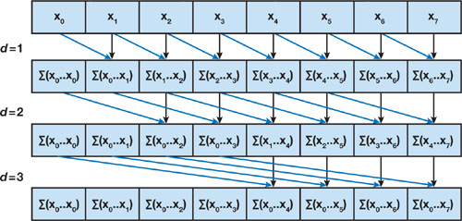
Prefix Sum (Scan)
Compared to naïve version, a slight better version – Hillis Steele Scan.
Iterate log(n) times: Threads stride to n: Add pairs of elements stride elements apart. Double stride at each iteration. (note must double buffer shared memory arrays)
This scan algorithm is not that work efficient
Sequential scan algorithm does n-1 adds
How many does this one do?
What happens if the # of elements is 10^6?
Notes:
N^2

Slide 25
Prefix Sum (Scan)
Even better one: Blelloch Scan.
Reduces in log(n), downsweeps in log(n).
Total steps: 2 log(n)
This scan algorithm is work efficient

Slide 26
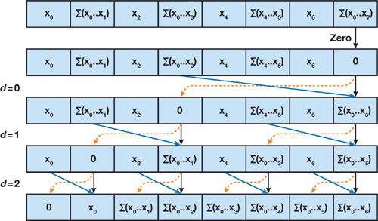
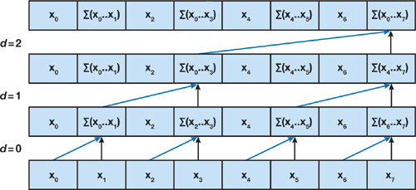
Prefix Sum (Scan)
Even better one: Blelloch Scan.
Reduces in log(n), downsweeps in log(n).
Total steps: 2 log(n)
This scan algorithm is work efficient

Slide 27
Prefix Sum (Scan)
Useful in implementation of several parallel algorithms:
Radix sort
Quicksort
String comparison
Lexical analysis
Stream compaction
Polynomial evaluation
Solving recurrences
Tree operations
histograms
Examples
Assigning camp slots
Assigning farmer market space
Allocating memory to parallel threads
Allocating memory buffer for communication channels
More info: https://developer.nvidia.com/gpugems/GPUGems3/gpugems3_ch39.html

Slide 28
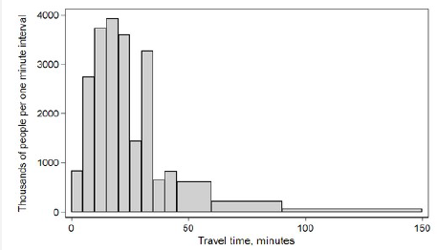
Histogram
A histogram is a graphical representation of the distribution of numerical data.
Bar Graph
Serial Algorithm
For (i=0; I < BIN_COUNT; i++)
result[i]=0;
For (i=0; I < measurements.size(); i++)
result[computeBin(measurements[i])]++;

Slide 29
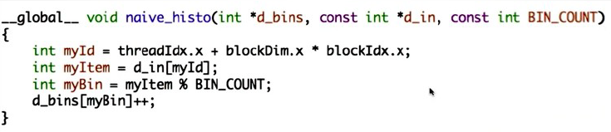
Histogram
Naïve implementation:
Notes:
Whats the problem here?

Slide 30
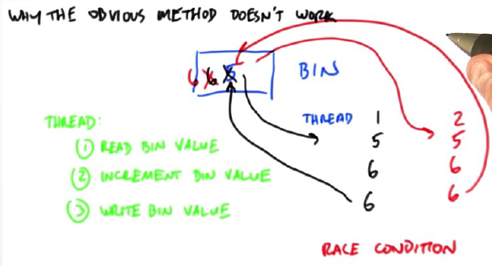
Histogram
Naïve implementation:

Slide 31
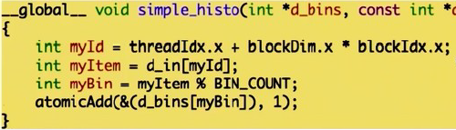
Histogram
Naïve implementation using atomic operations (Method 1):
This will avoid RAW hazards.

Slide 32
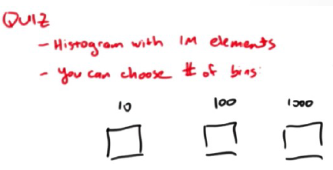
Histogram
Naïve implementation using atomic operations (Method 1):
This will avoid RAW hazards.
Notes:
Yo choose the highest amount
Whats the problem? Data dependent!
What happens if all the data falls into the same bin?

Slide 33
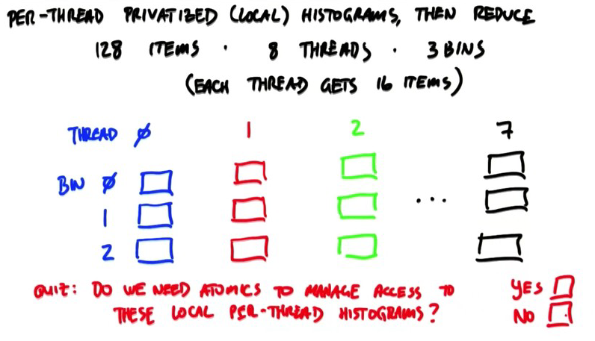
Histogram
Redefining the method. Local histogram + reduction (Method 2)

Slide 34
Histogram
Redefining the method. Local histogram + reduction (Method 2)

Slide 35
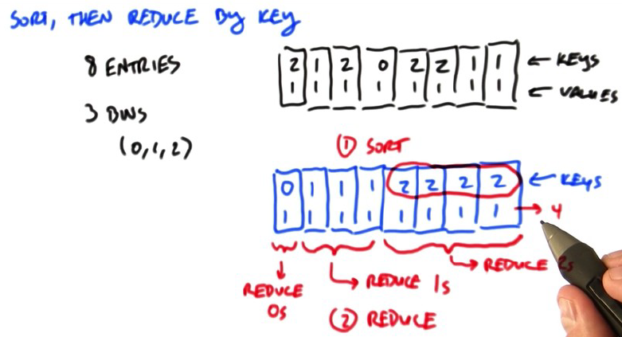
Histogram
Redefining the method. Sort then reduce by key (Method 3)

Slide 36
Histogram
Final thoughts on histogram:
Using Atomic operations
Using per-thread histograms, and then reduce
Sort, then reduce by key
Question
256 elements, 8 bins. How many atomic adds are needed?
Naive atomic technique. (256 threads)
Processing 16 elements per thread with local histogram, and then atomics.

Slide 37
Convolution
Applications
A popular array operation that is used in various forms in signal processing, digital recording, image processing, video processing, and computer vision.
Convolution is often performed as a filter that transforms signals and pixels into more desirable values
Some filters smooth out the signal values so that one can see the big-picture trend
Others like Gaussian filters can be used to sharpen boundaries and edges of objects in images

Slide 38
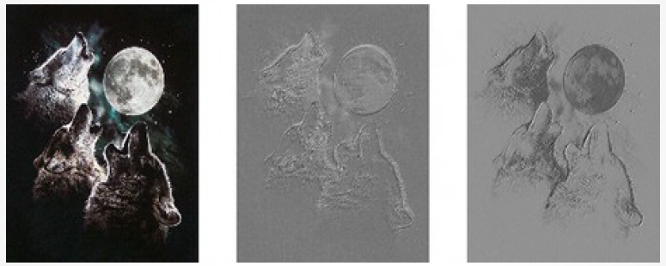
Convolution

Slide 39
Convolution
An array operation where each output data element is a weighted sum of a collection of neighboring input elements
The weights used in the weighted sum calculation are defined by an input mask array, commonly referred to as the convolution kernel
We will refer to these mask arrays as convolution masks to avoid confusion.
The same convolution mask is typically used for all elements of the array.

Slide 40
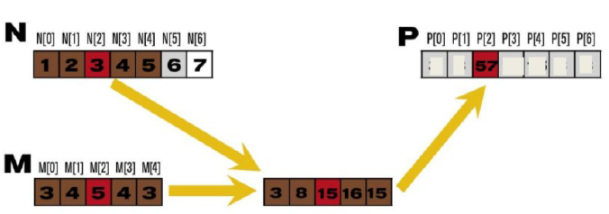
Convolution
1D Convolution example
Commonly used for audio processing
Mask size is usually an odd number of elements for symmetry

Slide 41
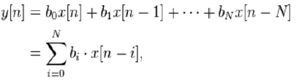
Convolution
Definition
For a causal discrete-time FIR filter of order N, each value of the output sequence is a weighted sum of the most recent input values:
Where:
X[n] is the input signal
Y[n] is the output signal,
N is the filter order, an Nth-order filter has (N+1) terms on the right-hand side
Bi is the value of the impulse response at the ith instance for 0<= I <= N of an Nth-order filter. If the filter is a direct form FIR filter then bi is also a coefficient of the filter.

Slide 42
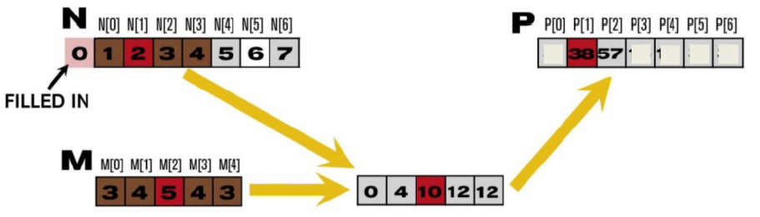
Convolution
Calculation of output elements near the boundaries (beginning and end) of the input array need to deal with “ghost” elements
Different policies (0, replicates of boundary values, etc.)

Slide 43
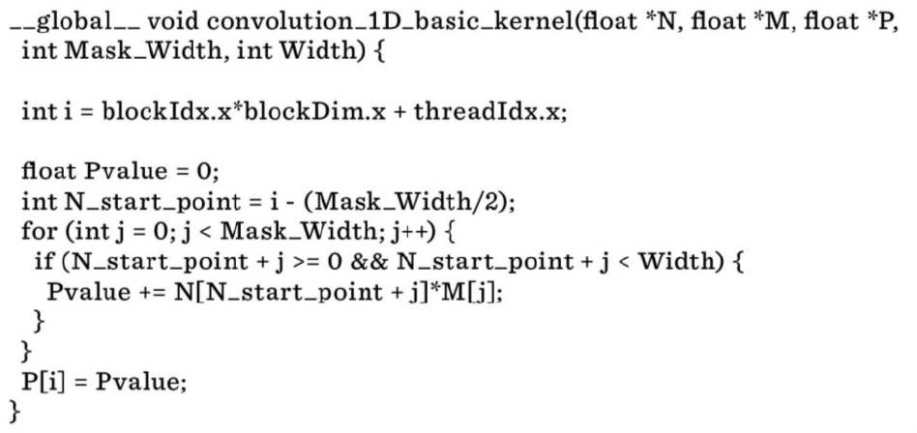
Convolution
This kernel forces all elements outside the vector range to 0

Slide 44
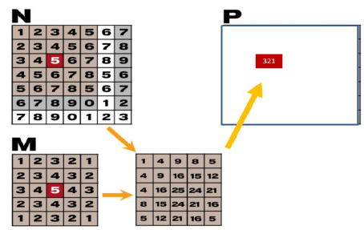
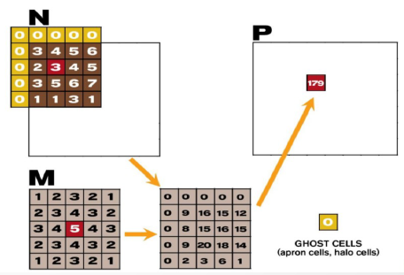
Convolution
2D convolution
2D convolution – ghost cells

Slide 45
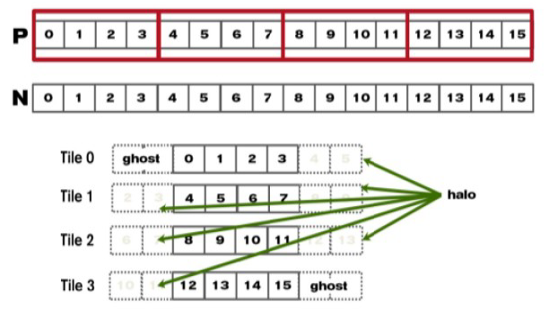
Convolution
Tiled Convolution for 1D

Slide 46
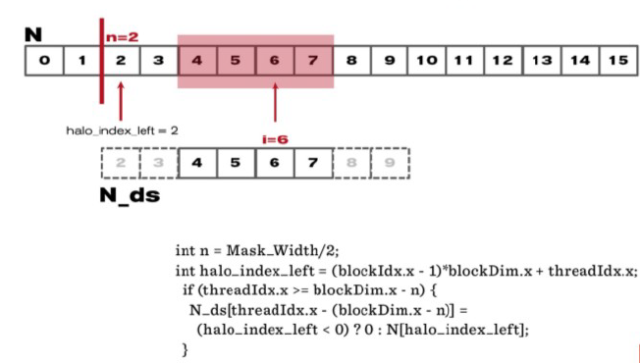
Convolution
Loading the left halo

Slide 47
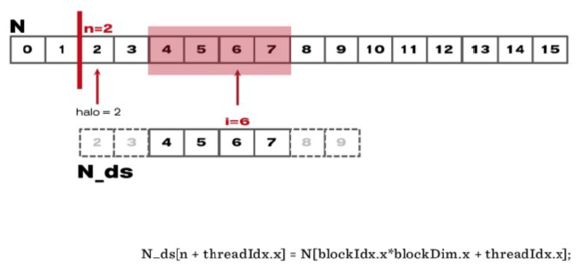
Convolution
Loading the internals

Slide 48
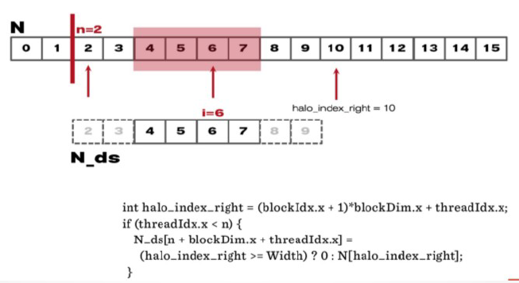
Convolution
Loading the right halo

Slide 49
Convolution

Slide 50
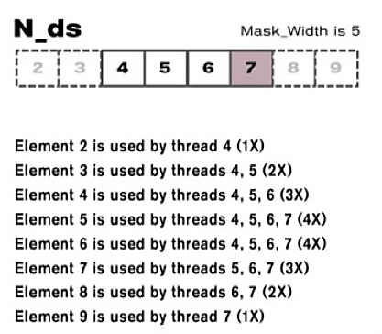
Convolution
Shared memory data reuse
Do we want to use Shared memory?

Slide 51
Convolution
Shared memory data reuse
Do we want to use Shared memory?
The Sobel filter is an example of this algorithm.
We also saw this in the shared memory lab. A lot of potential data reuse

Slide 52
Convolution
Shared memory data reuse
Do we want to use Shared memory?
The Sobel filter is an example of this algorithm.
We also saw this in the shared memory lab. A lot of potential data reuse

Slide 53

Last Session
(Project Presentations)
Will be on Tuesday November 27th, 2018
6:00 pm – 8:00 pm
Snell Engineering Center 108

